Slide 1
Definitions
From Latin littera
A message written by one person to another person or persons
A character used to write language
e.g. P or Ω
(plural) Literature generally
e.g. ‘a man of letters’

Slide 2
More Definitions
Epistle
From Greek ἐπιστολή, meaning ‘that which is sent over’
Often used to refer to letters written by early Christian apostles as preserved in the New Testament
Epistolary
Relating to letters

Slide 3
Types of Letters
Personal
Formal
Open
Literary

Slide 4
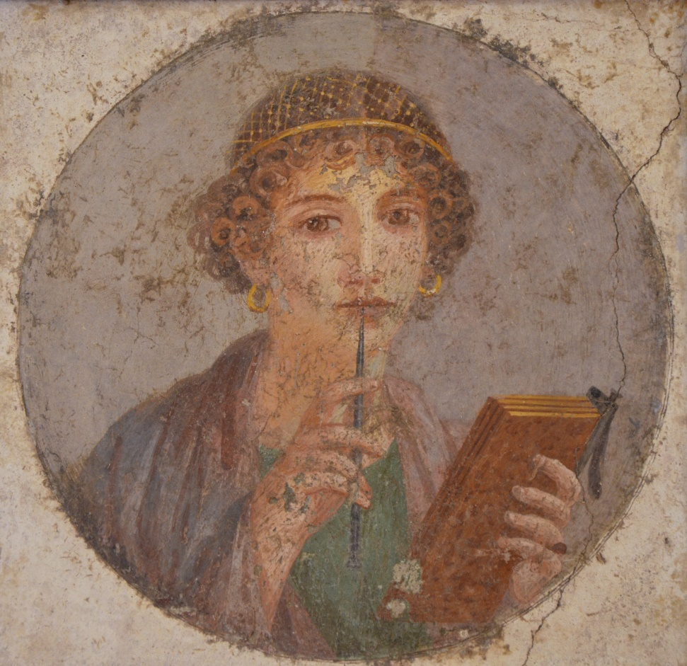
Technologies of Writing
Papyrus
Wax tablets
Epigraphy
Ostraca and wood tablets
Graffiti

Slide 5
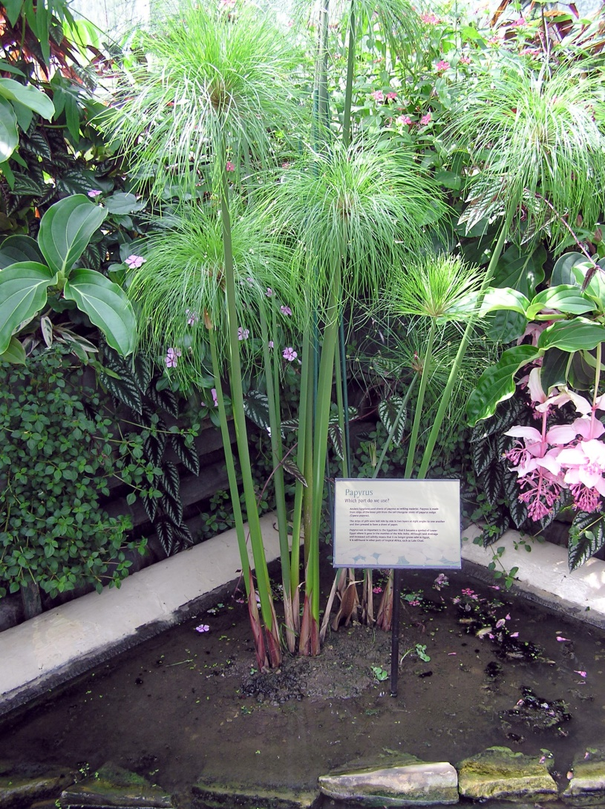
Papyrus
Plant native to Egypt
Stalks were sliced, layered and pounded flat to make sheets
Used in Egypt from c. 3000 BCE
Also used by the Greeks and Romans
Written on in ink made from soot using reed pens

Slide 6
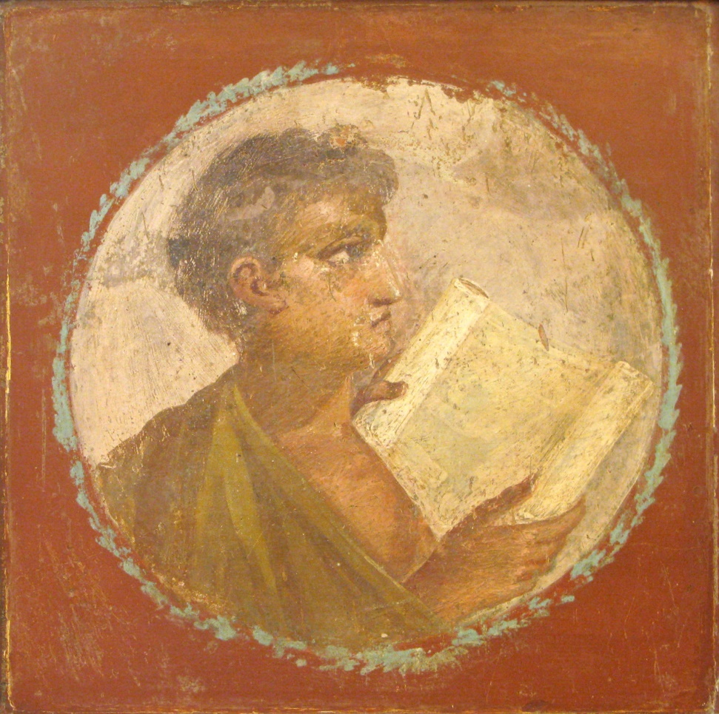
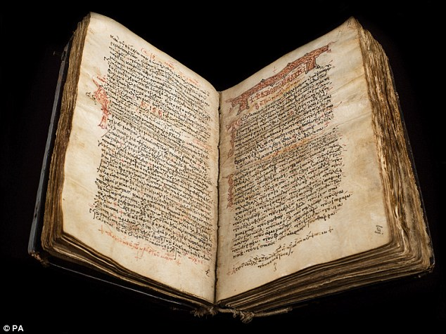
Rolls vs Codices (sing. Codex)

Slide 7
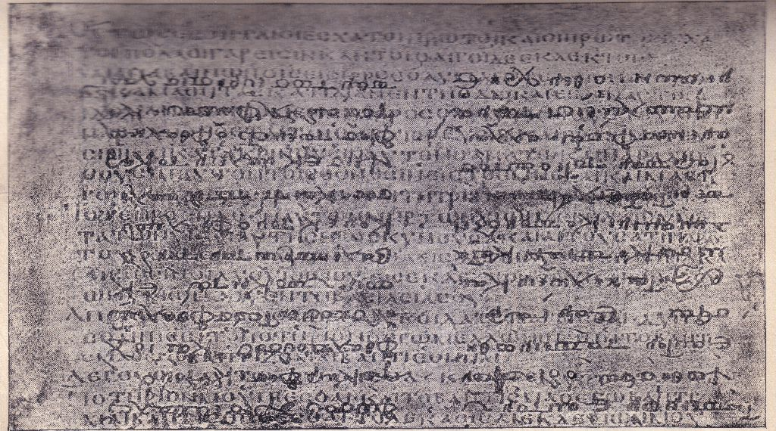
Palimpsest

Slide 8
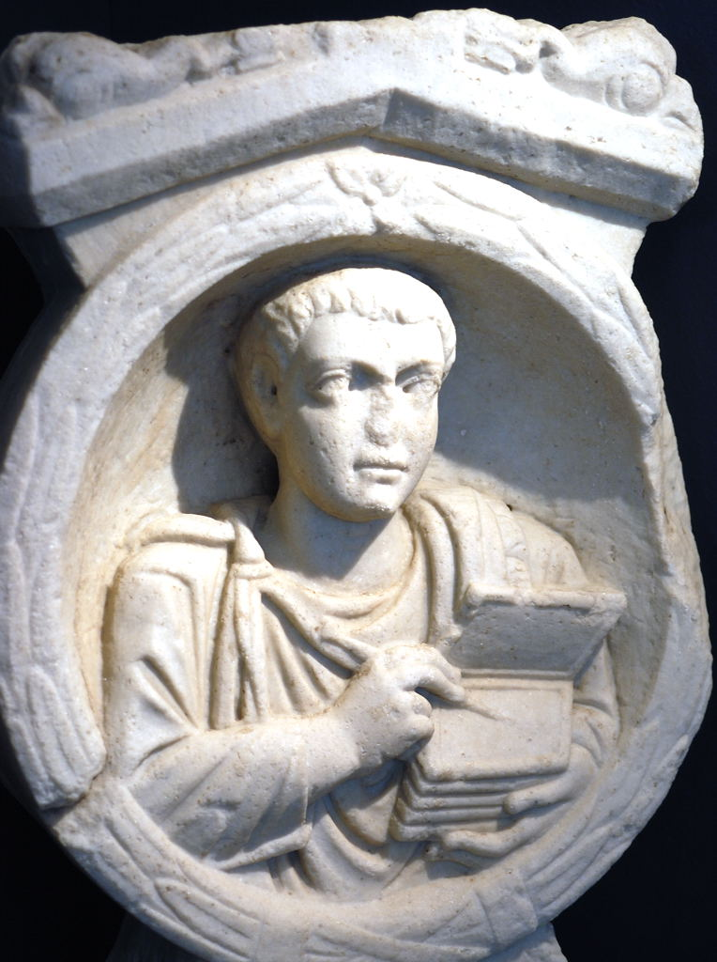
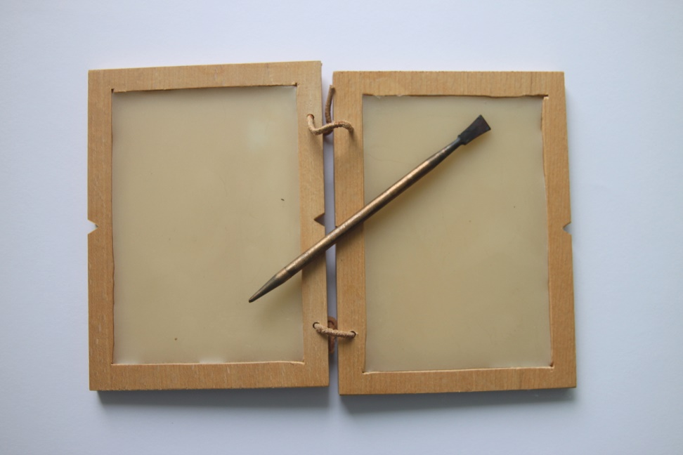
Wax Tablets

Slide 9
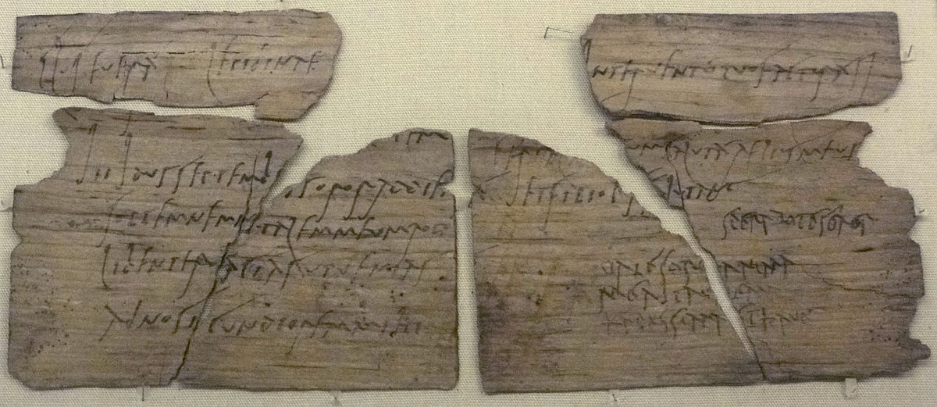
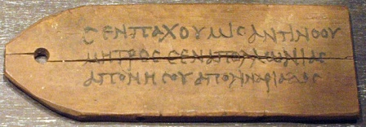
Wood

Slide 10
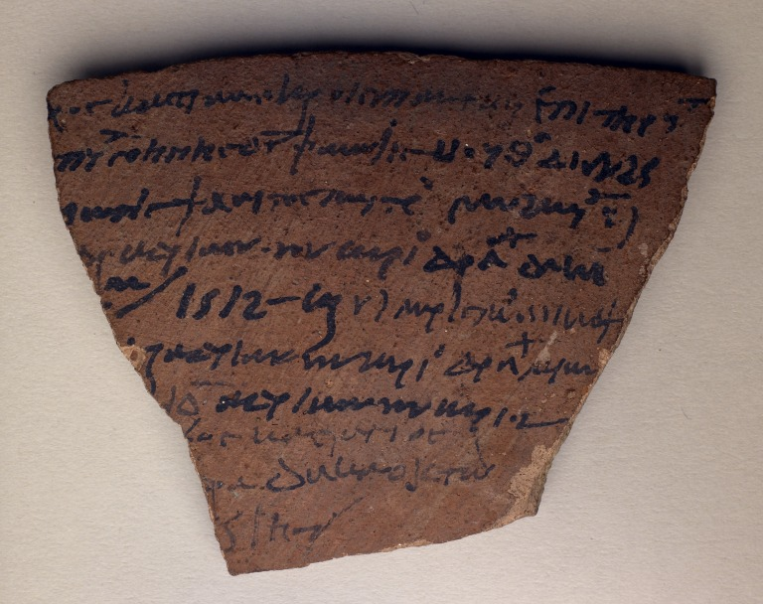
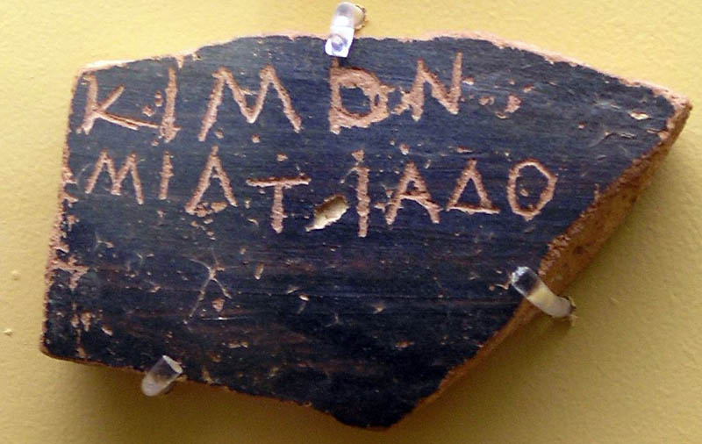
Ostraca

Slide 11
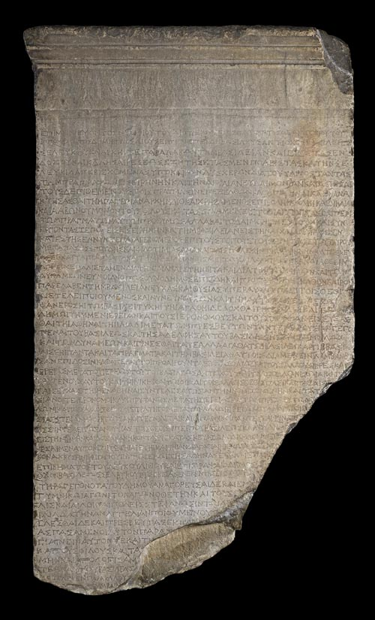
Epigraphy
Not practical for typical letters
But letters from kings, governors, emperors, etc. had legal force, and were often publically inscribed as a result

Slide 12
Technologies of Writing
Papyrus
Wax tablets
Ostraca and wood tablets
Epigraphy
Graffiti

Slide 13
Composition
Written by hand or dictated to a scribe
Multiple drafts using wax tablets?
Copies made of outgoing correspondance

Slide 14
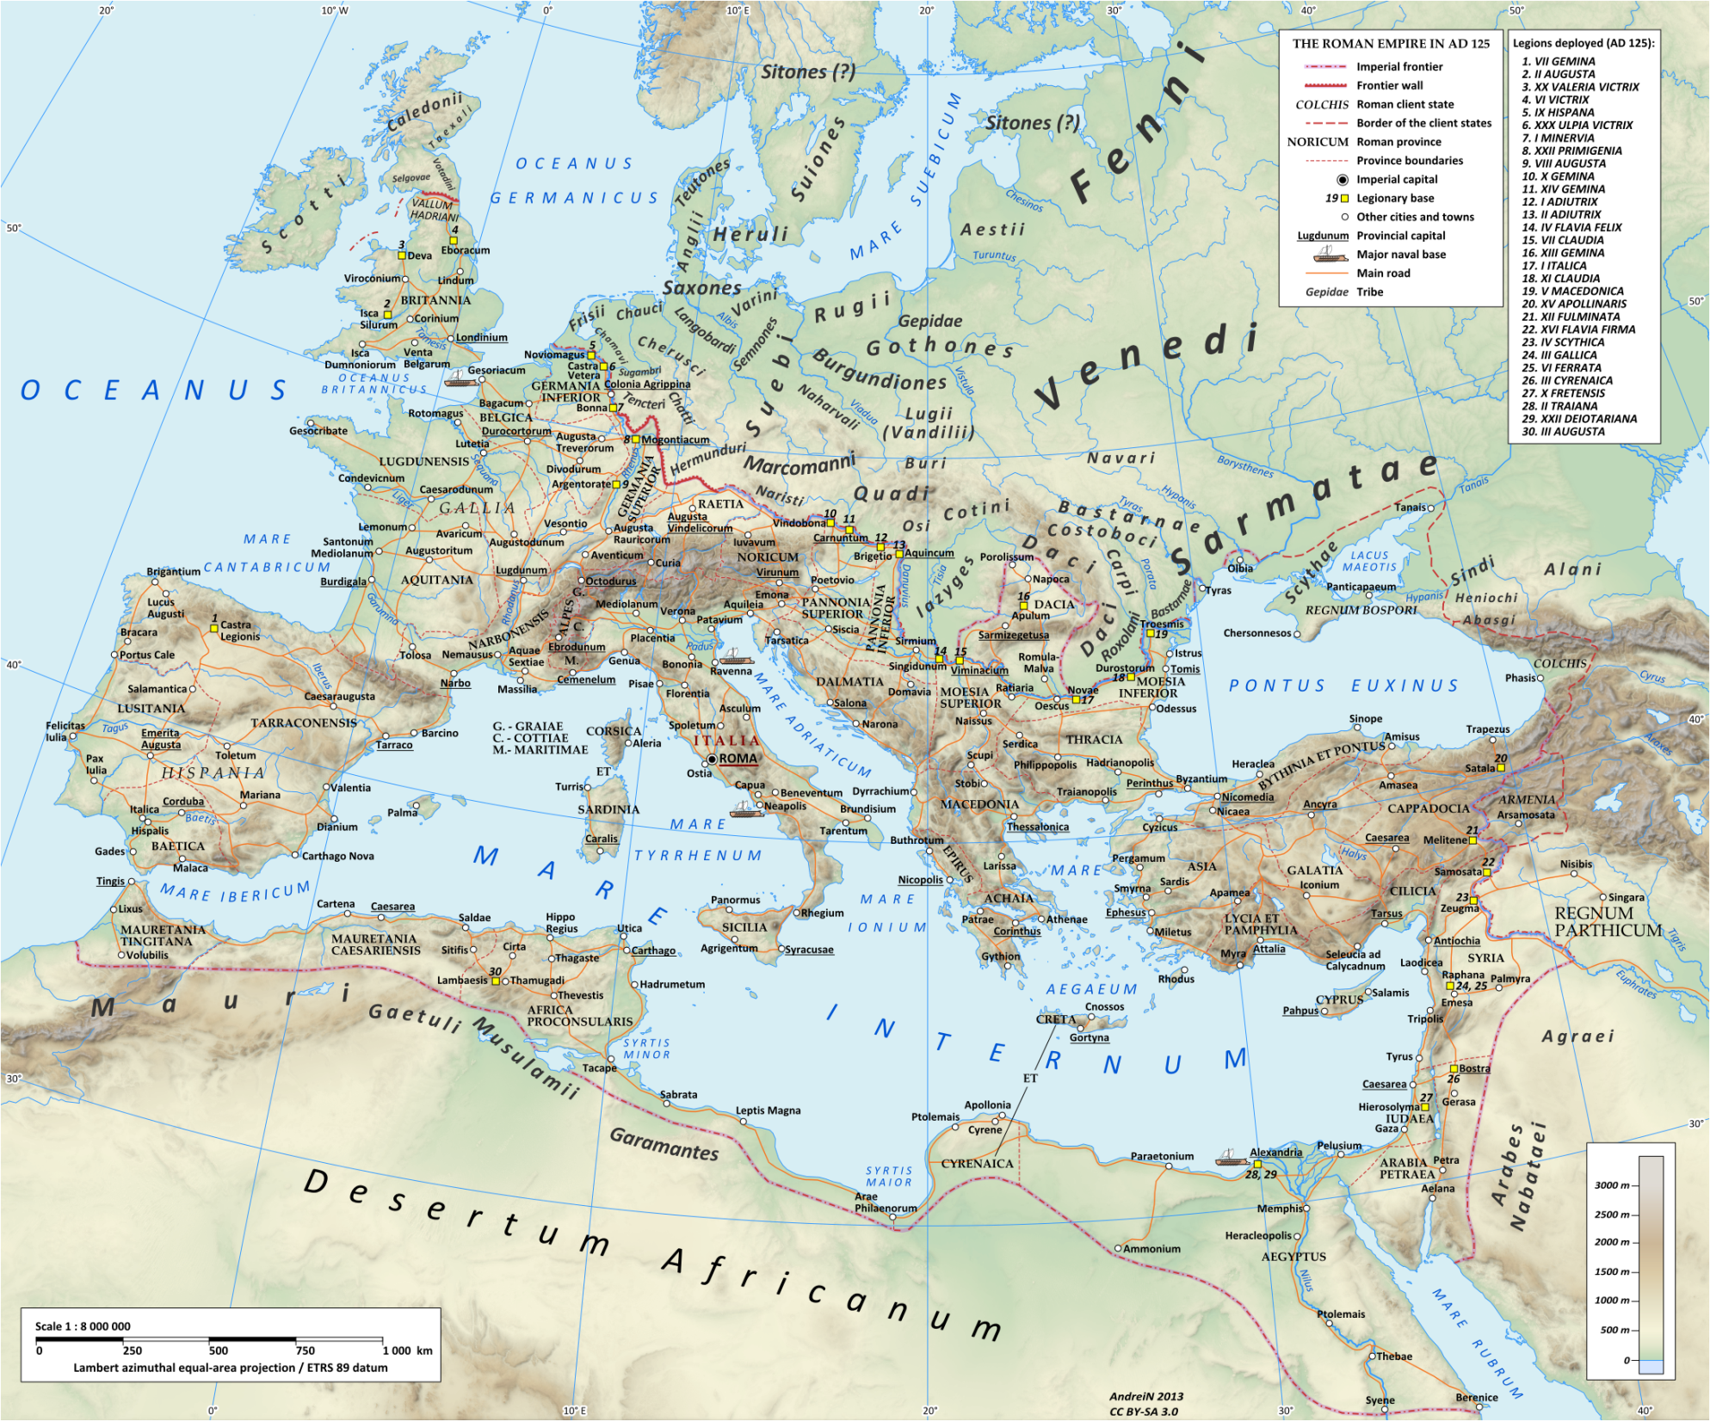
Roads
Mail

Slide 15
Sending Mail
“See that Acastus goes down to the harbor every day. There will be plenty of folk to whom you can safely give a letter and who will be glad to carry it for me. For my part I shall take advantage of every traveler to Patras.”
- Cicero, Ad Fam. 16.5 (50 BCE)

Slide 16
Sending Mail
“And yet I swear in the name of Him who presides over our friendship that I came down to the sea for this very purpose, ‘having given up the turf,’ and made a bargain with the oarsmen of Phycus whom I enjoined to give you my letters and...”
- Synesius of Cyrene, Ep. 129 (403 CE)

Slide 17
Receiving Mail
“I rejoiced greatly on receiving your letter which was given to me by the sword-maker, though I have not received the one which you say you have sent me by Plato, the dancer’s son.”
- P. Oxy. 1676 (3rd cen. CE)

Slide 18
Reading Mail
“By Sarapis! You, whoever you are, who are reading the letter, make a small effort and translate to the women what is written in this letter and tell them.”
- P. Haun. 14 + P. Mich. 679 + P. Haun. 15

Slide 19
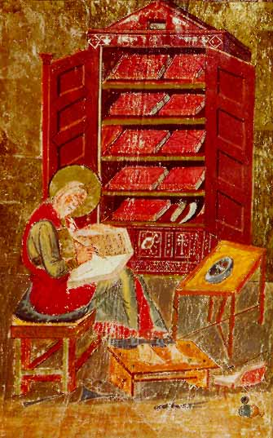
Publication of Letters
Publication = allowing a text to be copied by hand
Letters had to be collected and edited prior to publication
Cicero’s letters were collected and edited by his secretary Tiro after his death

Slide 20
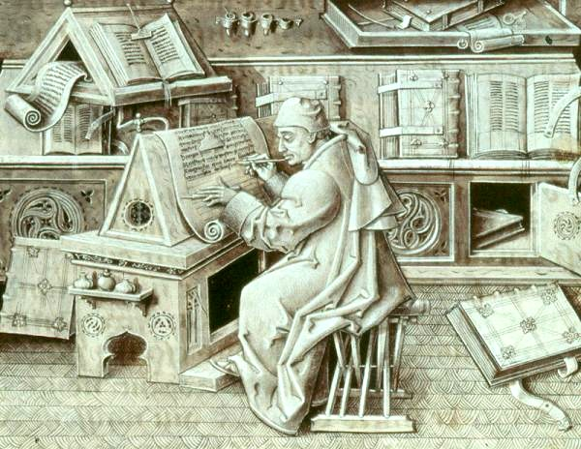
Survival
Jean Miélot, French monk (died 1472 CE)

Slide 21
Why Letters?
Personal interactions
Social history
Natural phenomena
Politics

Slide 22
Discussion Questions
Who wrote this letter? When and where was it written? In what language was it written originally (i.e., Latin, Greek)?
To whom is it addressed? Is it meant to be read by this recipient only, or by a larger audience?
What are the author’s goals in writing this letter? What is he or she trying to communicate? How does he or she go about achieving that goal? Is he or she successful?
What can we learn about Roman society from this letter?

Slide 23
Our Theorists
‘Demetrius’ (= Zeiner-Carmichael no. 215)
Greek, c. 2nd cen. BCE?
‘Libanius’ (= Zeiner-Carmichael no. 216)
Greek, c. 5th cen. CE?
Lucius Annaeus Seneca (= Trapp no. 74)
Latin, c. 60s CE
Julius Victor (= Trapp no. 75)
Latin, c. 4th cen. CE?

Slide 24
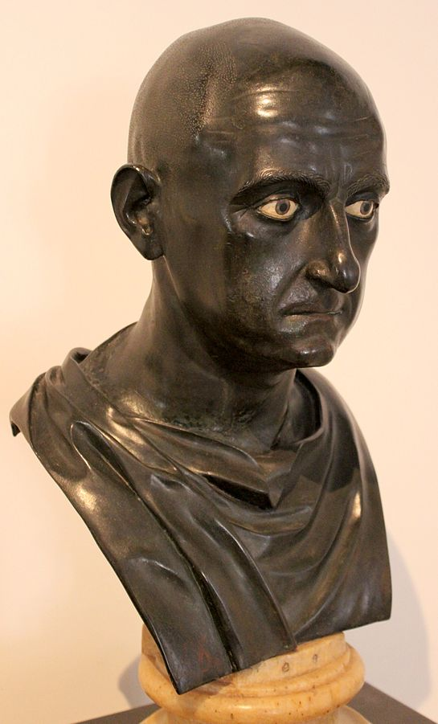
Roman Male Names
Praenomen: first name
e.g. Marcus, Lucius, Publius
Nomen: clan name
e.g. Cornelius, Tullius
Cognomen: family name
e.g. Cicero, Scipio, Cato
Agnomen: honorary name
e.g. Africanus
Citizens only!
Publius Cornelius Scipio Africanus
c. mid 1st cen. BCE

Slide 25
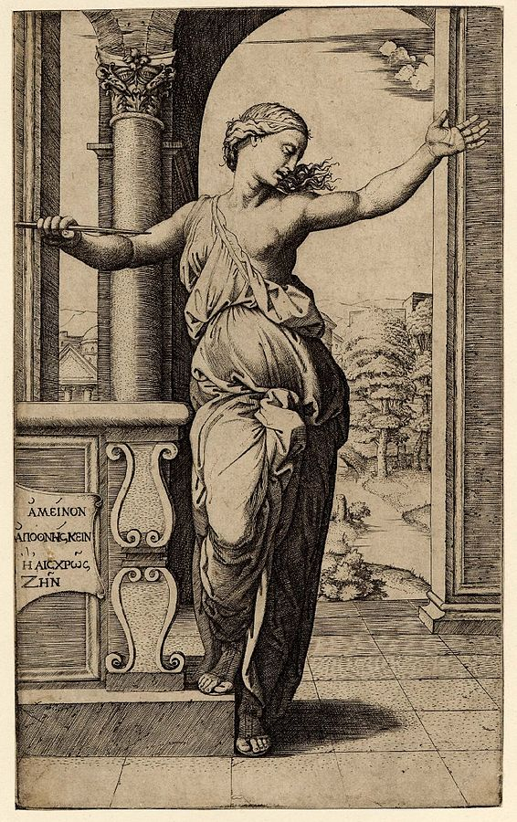
Roman Female Names
Nomen: clan name
e.g. Cornelia, Lucretia
Engraving of Lucretia by Marcantonio Raimondi (1534)

